Slide 1
The Rady School of Management
MGT 103 Lecture #13
Pricing Strategy- Pricing Levers, Final Price
February 24, 2020

Slide 2
Group Marketing Plan – 5-minute meet and greet
Find your groups, exchange email/phone #’s
Set up group planning times
Team Leader Reminder – Mandatory Office Hour on Monday, February 24th at 1:30, Rady Undergrad Conference Room

Slide 3
LEARNING OBJECTIVES (LO) AFTER READING CHAPTER 13, YOU SHOULD BE ABLE TO:
Identify the elements that make up a price.
Recognize the objectives a firm has in setting prices and the constraints that restrict the range of prices a firm can charge.
Explain what a demand curve is and the roles of revenues in pricing decisions.
Describe what price elasticity of demand means to a manager facing a pricing decision.
Explain the role of costs in pricing decisions and describe how various combinations of price, fixed cost, and unit variable cost affect a firm’s break-even point.

Slide 4

VIZIO, INC.—BUILDING A SMART TV BRAND AT A GREAT VALUE
Largest U.S.-based TV Maker? VIZIO!
Strategy: Affordable HDTVs
Did Not Invest in Expensive Manufacturing Facilities
Relies on Contract Manufacturer to Build Product
Sold at Costco, Walmart, Best Buy, Target…
The Smart TV Market Leader in North America
Value-Based Pricing Strategy
Ranked “Highest in Customer Satisfaction”
Vizio Video

Slide 5
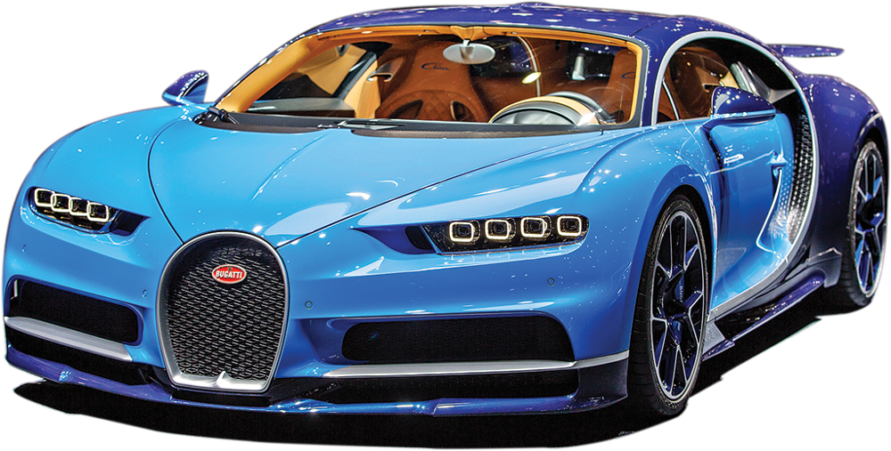

NATURE AND IMPORTANCE OF PRICE WHAT IS A PRICE?
Price
Barter
The Price Equation
Calculating a Final Price
Top: ©CTK/Alamy Stock Photo; Bottom: ©Drive Images/Alamy Stock Photo

Slide 6
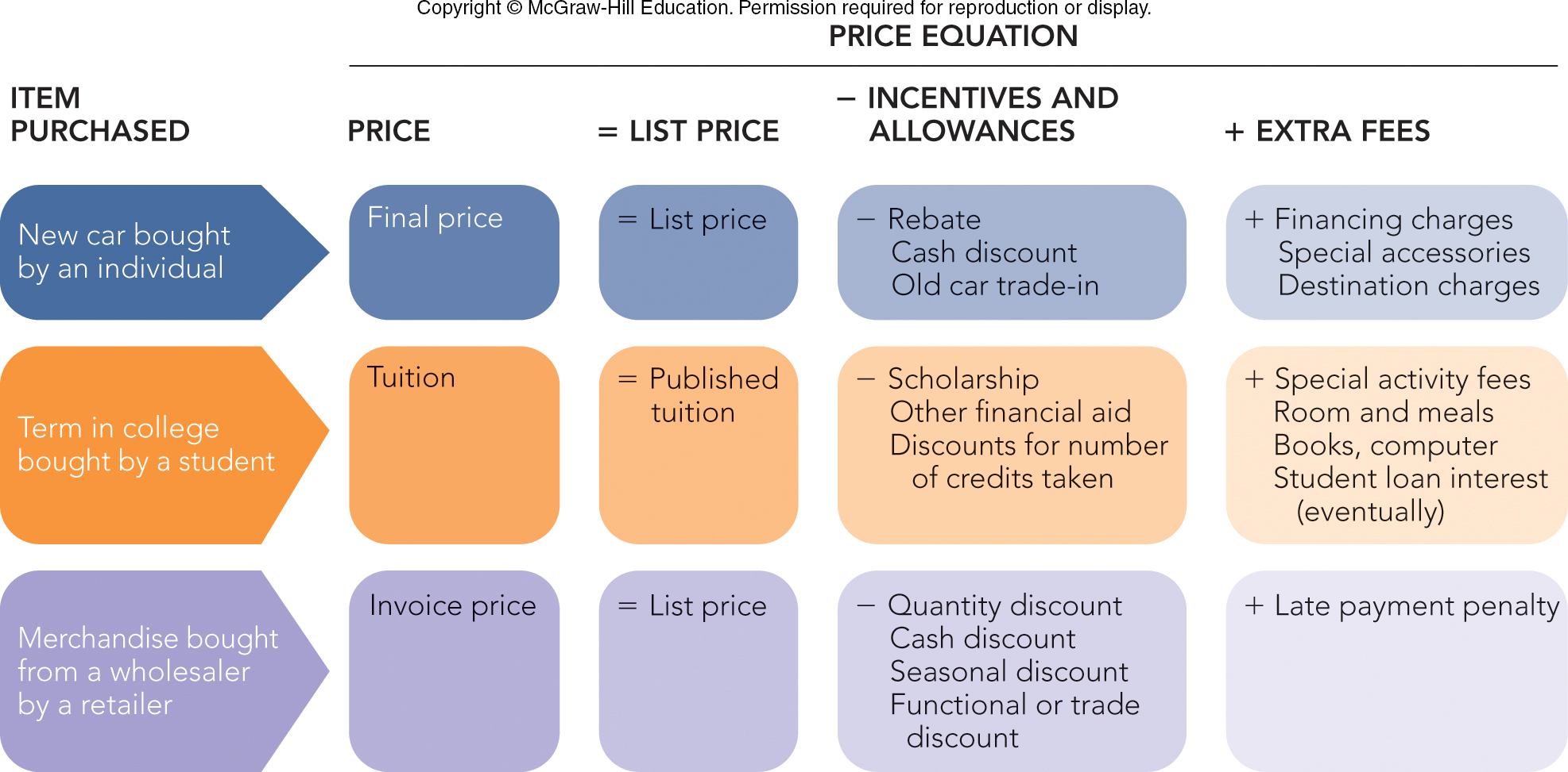
FIGURE 13-1 The “price” a buyer pays can take different names depending on what is purchased

Slide 7
NATURE AND IMPORTANCE OF PRICE PRICE AS AN INDICATOR OF VALUE
Value
Value-Pricing

Slide 8

MARKETING MATTERS Does Spirit Airlines Engage in Value Pricing? For Some Yes, for Others No
It Depends on the Benefits to Passengers, and the Price Passengers are Willing to Pay
Spirit Is 40 Percent Lower Than Competitors
Pay Extra for Boarding Pass, Beverages, Overhead Bin, Assigned Aisle Seat, and More
Value Pricing:
Yes, for Those Who Want to Get to Destination Cheaply
No, for Those Who Expect More Benefits
Ranks High for Complaints on Seats, etc., but Not for Fares
©Sam Pollitt/Alamy Stock Photo

Slide 9
NATURE AND IMPORTANCE OF PRICE PRICE IN THE MARKETING MIX
Profit Equation
Profit = Total Revenue – Total Cost
Six Steps in Setting Price
Identify Pricing Objectives/Constraints
Estimate Demand and Revenue
Determine Cost, Volume, Profit Relationships
Select Approximate Price Level
Set List or Quoted Price
Make Special Adjustments

Slide 10
STEP 1: IDENTIFY PRICING OBJECTIVES AND CONSTRAINTS IDENTIFYING PRICING OBJECTIVES (1 of 6)
Pricing Objectives
Profit
Return on Investment (ROI)
Return on Assets (ROA)
Managing for Long-Run Profits
Maximizing Current Profit Objective
Target Return (Profit Goal)

Slide 11
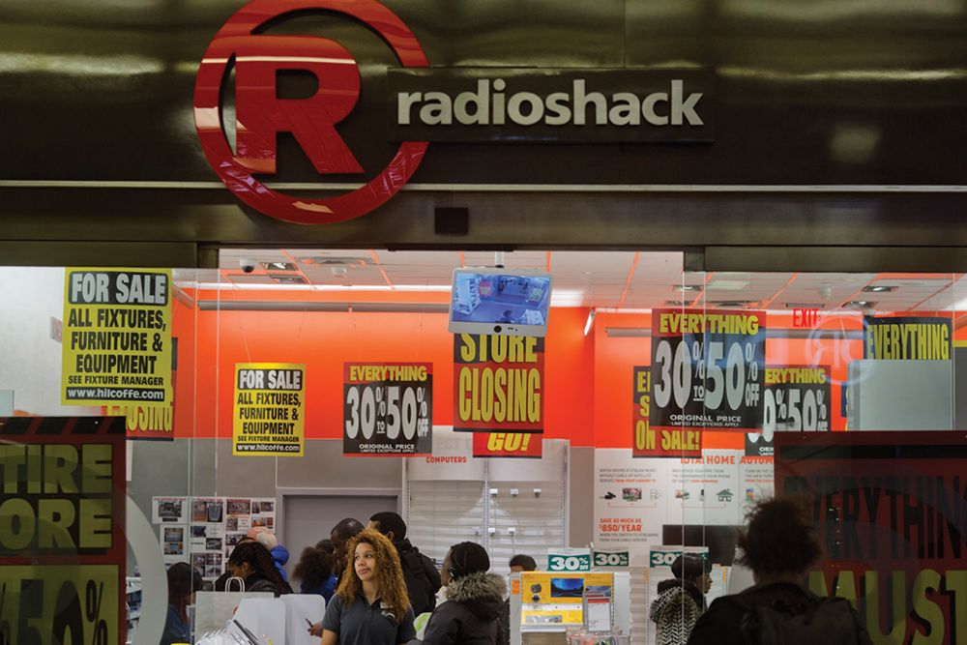
STEP 1: IDENTIFY PRICING OBJECTIVES AND CONSTRAINTS IDENTIFYING PRICING OBJECTIVES (2 of 6)
Pricing Objectives
Sales Revenue ($)
Market Share ($ or %)
Unit Volume (#)
Survival
Social Responsibility
©Victor J. Blue/Bloomberg via Getty Images

Slide 12
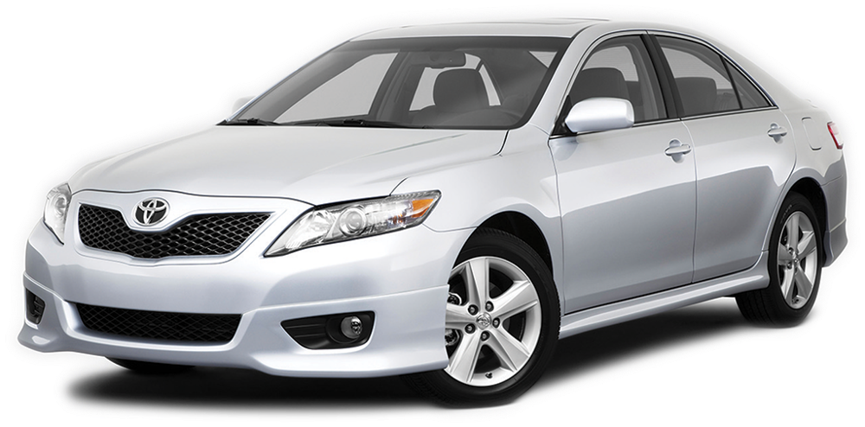
STEP 1: IDENTIFY PRICING OBJECTIVES AND CONSTRAINTS IDENTIFYING PRICING CONSTRAINTS (3 of 6)
Pricing Constraints
Demand for the Product Class, Product Group and Brand
(Cars, Sedan, Specific Brand)
Newness of the Product: Stage in the Product Life Cycle
Newer Products Usually Priced Higher
©Drive Images/Alamy Stock Photo

Slide 13

STEP 1: IDENTIFY PRICING OBJECTIVES AND CONSTRAINTS IDENTIFYING PRICING CONSTRAINTS (4 of 6)
Pricing Constraints
Cost of Producing and Marketing the Product
Profit for Channel Members
Cost of Changing Prices and the Time Period They Apply
©Amanda Edwards/Getty Images

Slide 14
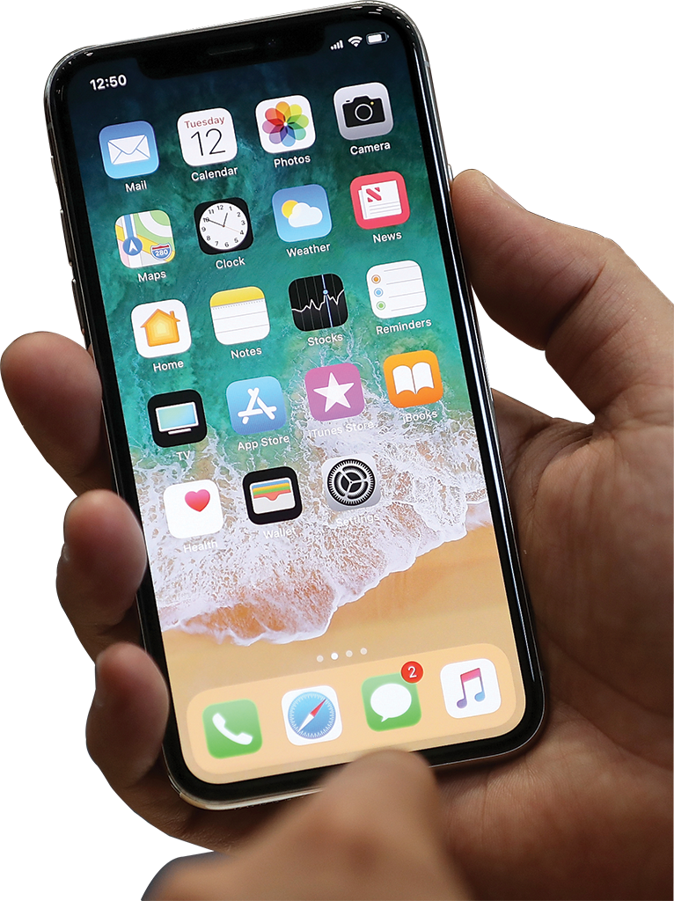
STEP 1: IDENTIFY PRICING OBJECTIVES AND CONSTRAINTS IDENTIFYING PRICING CONSTRAINTS (5 of 6)
Pricing Constraints
Single Product versus a Product Line
Example: In 2017 Apple Unveiled Three Phones at Once and Had to Consider Value and Price of All Three
Type of Competitive Market
Pure Competition
Monopolistic Competition
Oligopoly
Pure Monopoly
©Justin Sullivan/Getty Images

Slide 15
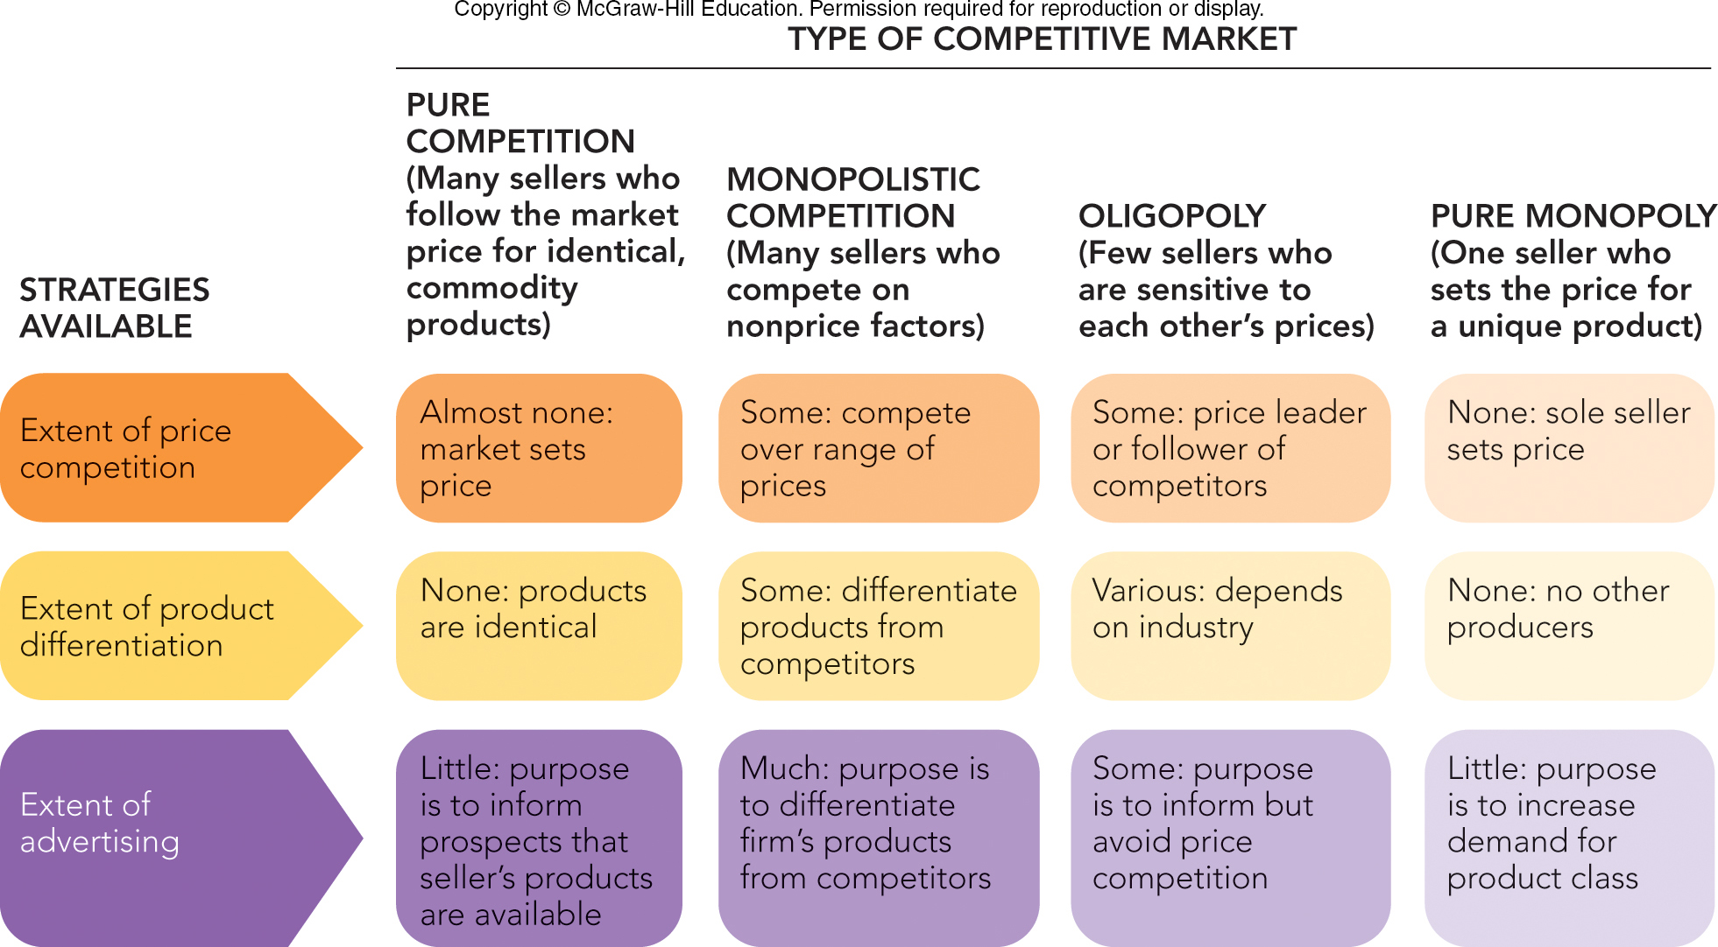
FIGURE 13-3 Pricing, product, and advertising strategies available to firms in four types of competitive markets
Jump to Appendix 3 long image description

Slide 16

STEP 1: IDENTIFY PRICING OBJECTIVES AND CONSTRAINTS IDENTIFYING PRICING CONSTRAINTS (6 of 6)
Pricing Constraints
Competitors’ Prices and Consumers Awareness of Them and Ability to Easily Purchase Them
Consumer-Driven Pricing Actions
Seller/Retailer-Driven Pricing Actions
Legal and Ethical Considerations
©Kevork Djansezian/Getty Images

Slide 17
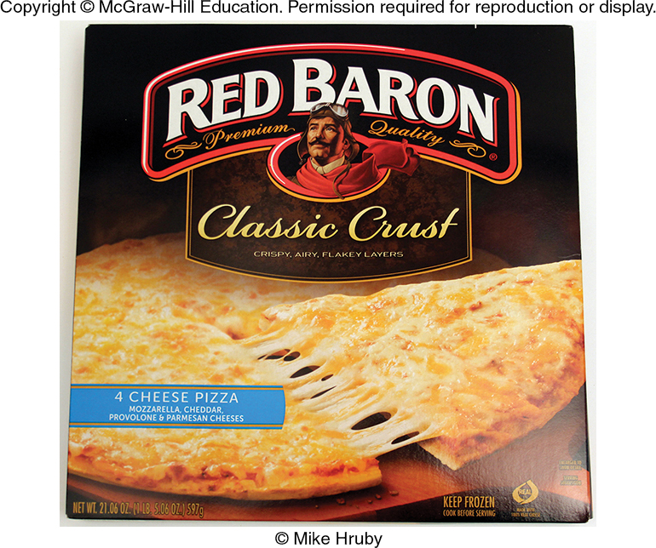
STEP 2: ESTIMATE DEMAND AND REVENUE ESTIMATING DEMAND (1 of 4)
Demand Curve
Demand Factors:
Consumer Tastes
Price and Availability of Similar Products
Consumer Income
©McGraw-Hill Education/Mike Hruby, photographer

Slide 18
STEP 2: ESTIMATE DEMAND AND REVENUE ESTIMATING DEMAND (2 of 4)
Movement Along versus Shift of a Demand Curve
Movement Along a Demand Curve
Shift in the Demand Curve
©McGraw-Hill Education/Mike Hruby, photographer

Slide 19
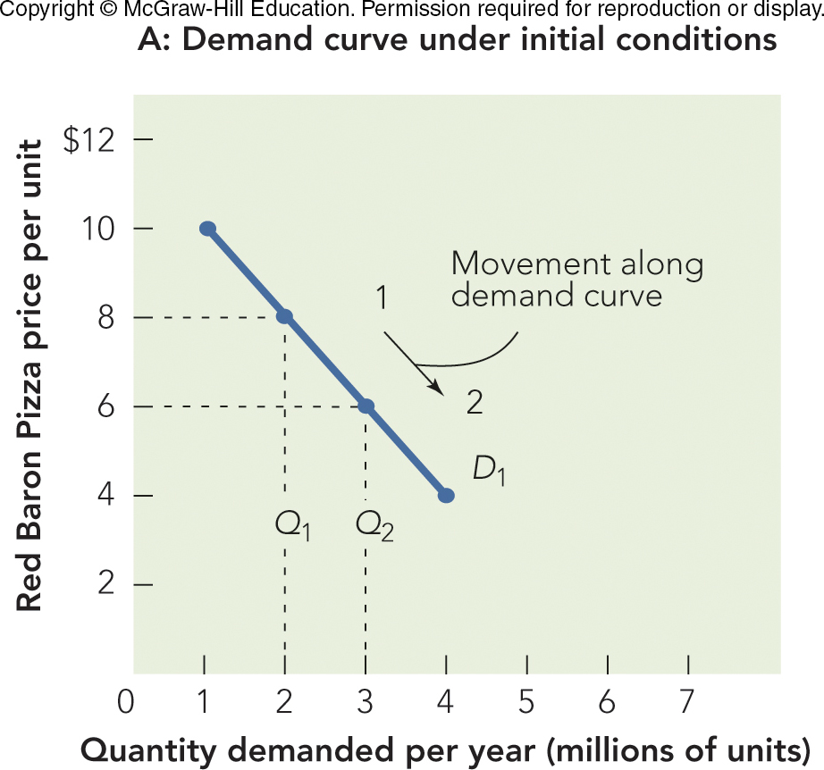
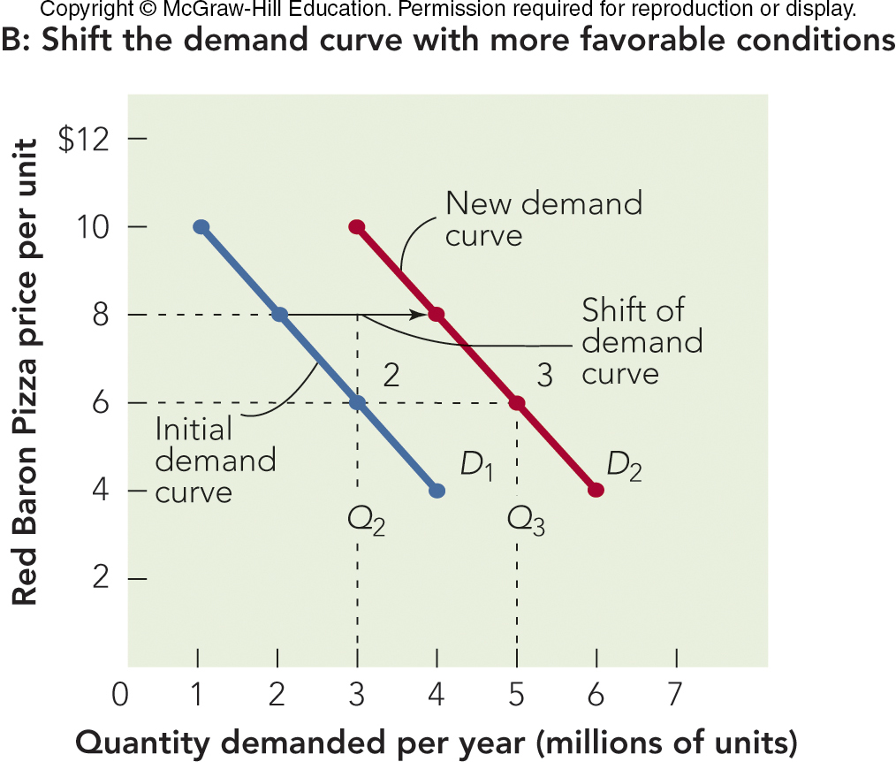
FIGURE 13-4 Demand curves for Red Baron frozen cheese pizza showing the effect on annual sales by a change in price caused by (A) a movement along the demand curve and (B) a shift of the demand curve

Slide 20
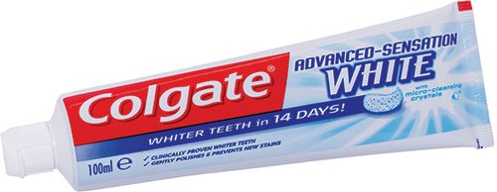
STEP 2: ESTIMATE DEMAND AND REVENUE ESTIMATING REVENUE (3 of 4)
Price Elasticity of Demand
Elastic Demand: 1 Percent Price Decrease Generates More than 1 Percent Quantity Increase
Inelastic Demand: 1 Percent Price Decrease Produces Less than 1 Percent Quantity Increase
How Price Elasticity Affects Marketing and Public Policy Decisions
Necessities are Price Inelastic
©razorpix/Alamy Stock Photo

Slide 21
MARKETING MATTERS Using Big Data to Curb Smoking: Uncovering the Price Elasticity of Demand for Cigarettes
Factors Affecting Price Elasticity:
Geography
Education
Income
Age
Findings:
Younger Consumers Likely to Reduce Number of Cigarettes if Prices Increase

Slide 22
STEP 2: ESTIMATE DEMAND AND REVENUE ESTIMATING REVENUE (4 of 4)
Marketing Executives Consider “Demand Curves” to Be “Revenue Generated”
Demand Curves Lead to “Total Revenue”
Total Revenue (TR)
TR = P x Q
©McGraw-Hill Education/Mike Hruby, photographer

Slide 23
STEP 3: DETERMINE COST, VOLUME, AND PROFIT RELATIONSHIPS THE IMPORTANCE OF CONTROLLING COSTS
Total Cost (TC)
Fixed Cost (FC)
Variable Cost (VC)
Unit Variable Cost (UVC)

Slide 24
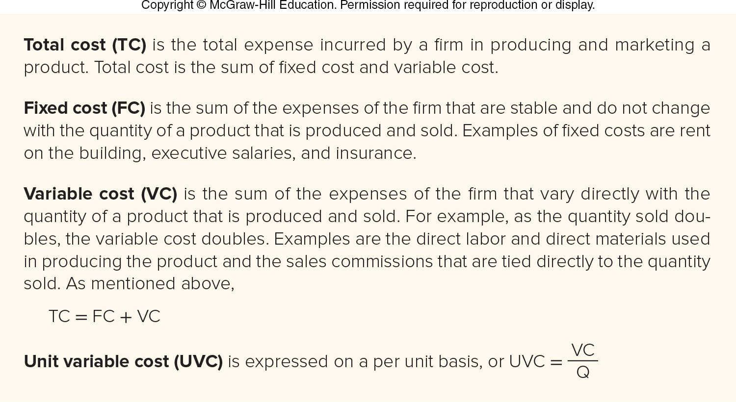
FIGURE 13-5 Fundamental cost concepts

Slide 25
STEP 3: DETERMINE COST, VOLUME, AND PROFIT RELATIONSHIPS BREAK-EVEN ANALYSIS
Break-Even Analysis
Break-Even Point (BEP)
Break-Even Chart

Slide 26
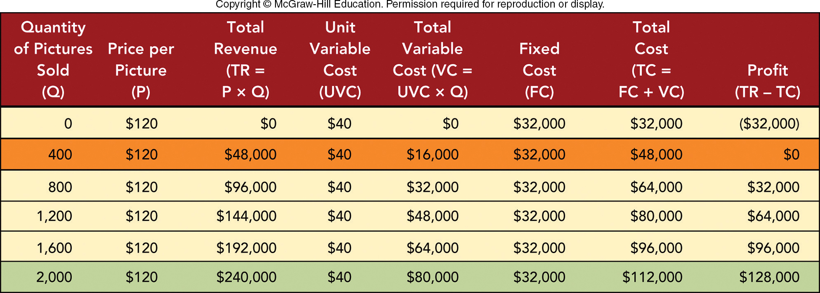
FIGURE 13-6 Calculating a break-even point for the picture frame store shows its profit starts at 400 framed pictures per year

Slide 27
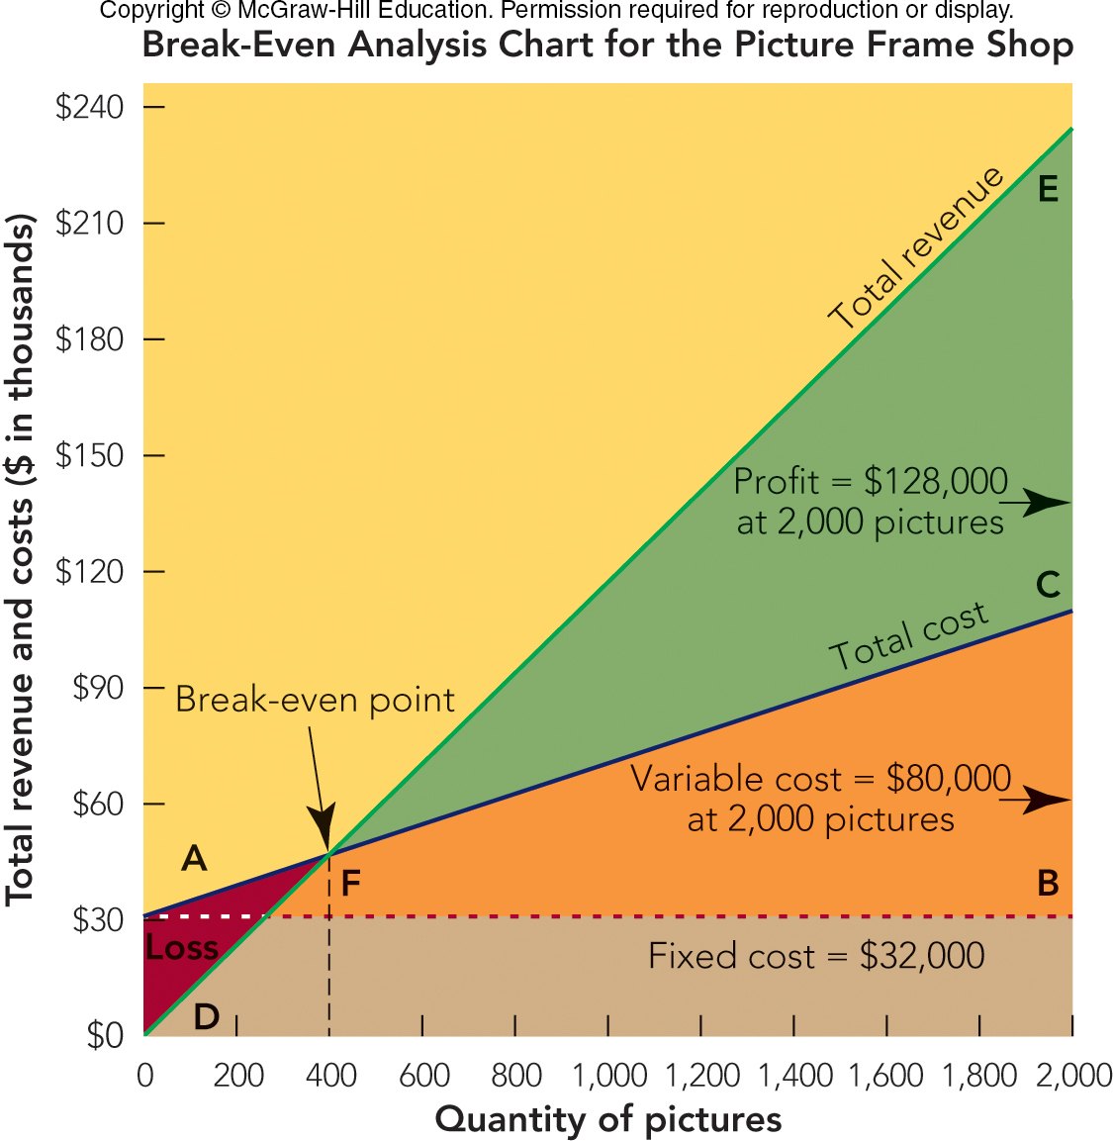
FIGURE 13-7 Break-even analysis chart for a picture frame store shows the break-even point at 400 pictures

Slide 28

E-BOOKS AND E-CONOMICS: A TWISTED TALE OF PRICING FOR PROFIT
E-Readers Were a Disruptive Change in Publishing
Change Began with Amazon’s Kindle and $9.99 eBooks
Today, Publisher Sets E-Book Prices and Pays Commission to Distributors
© Daniilantiq/Getty Images

Slide 29
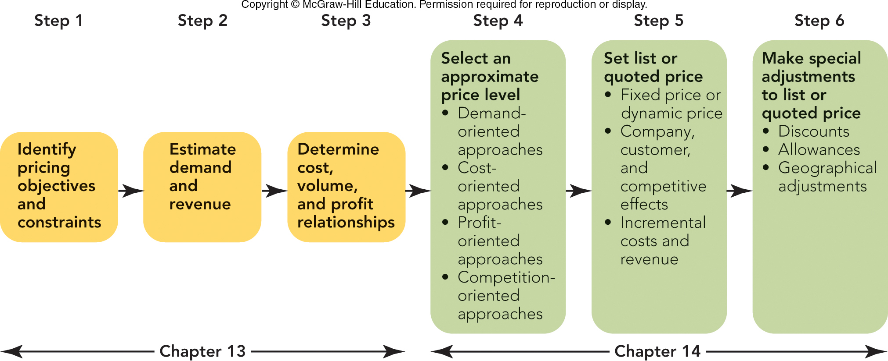
FIGURE 14-1 The six steps in setting price. The first three steps were covered in Chapter 13, and the last three steps in this chapter.

Slide 30
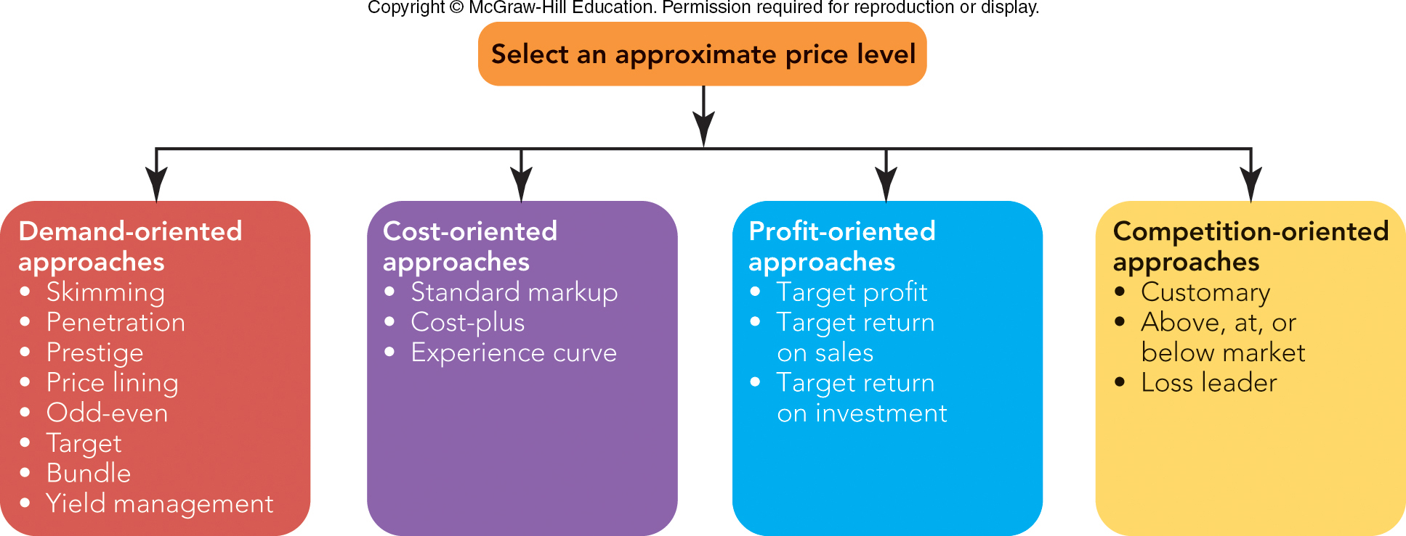
FIGURE 14-2 Four approaches for selecting an approximate price level

Slide 31

STEP 4: SELECT AN APPROPRIATE PRICE LEVEL DEMAND-ORIENTED PRICING APPROACHES (1 of 2)
Skimming Pricing
Penetration Pricing
Prestige Pricing
Price Lining
Rolex Ad

Slide 32
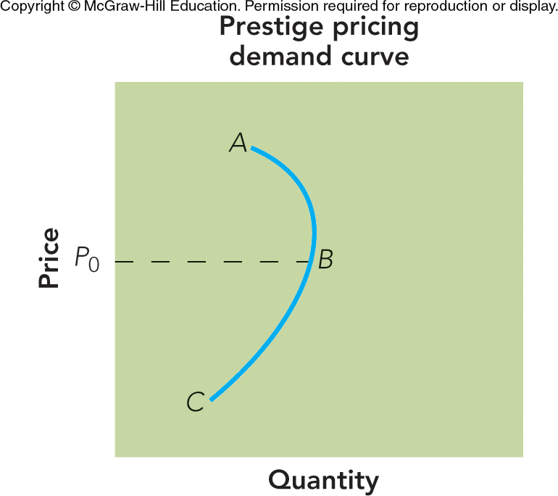
FIGURE 14-3 For prestige pricing, the demand curve for high-quality products is backwards sloping
“sweet spot”

Slide 33
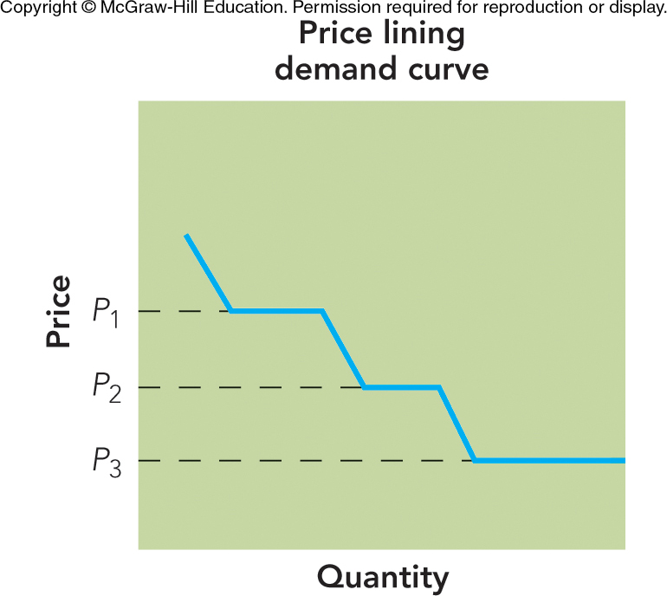
FIGURE 14-4 For price lining, the demand curve is elastic at each price point but inelastic between price points
iPhone 10XS, 10XR, 8
Pricing to a “sweet spot”

Slide 34
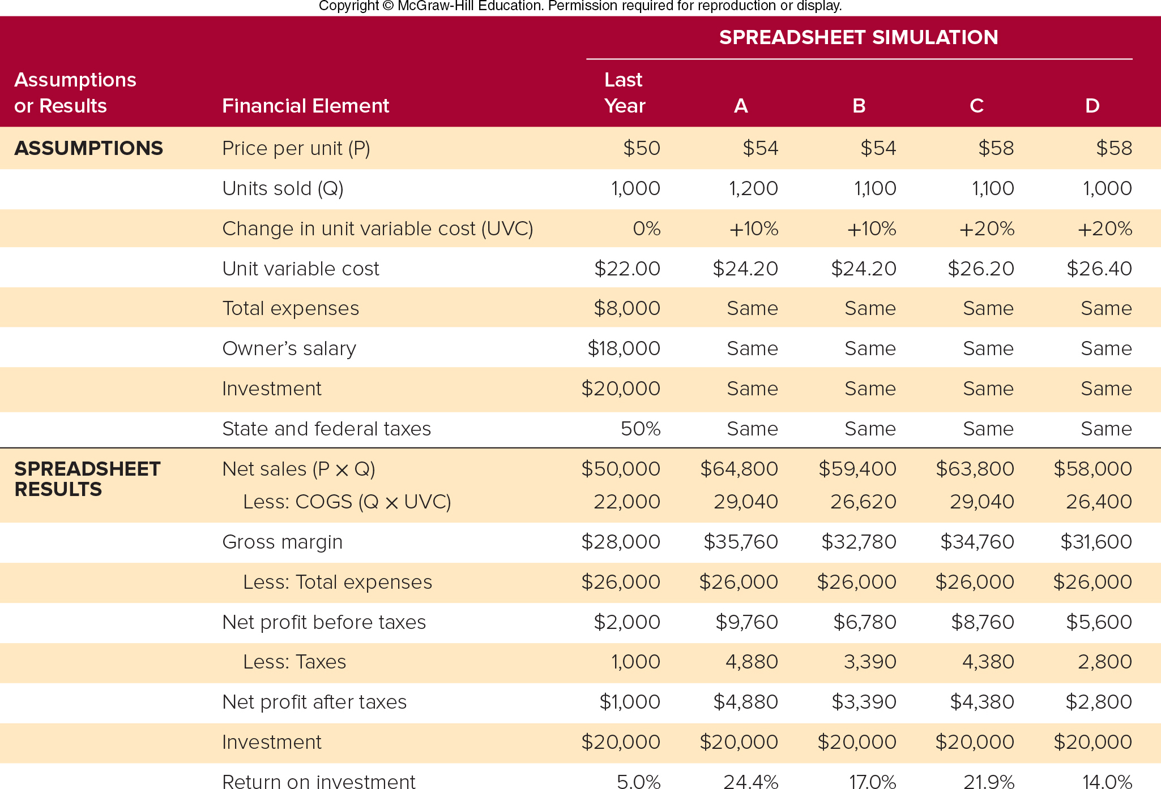
FIGURE 14-5 Results of a spreadsheet simulation to select a price that will achieve a target return on investment

Slide 35
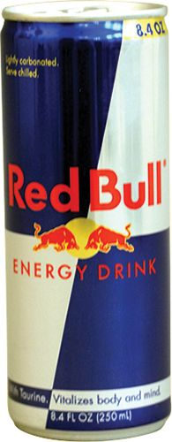
STEP 4: SELECT AN APPROPRIATE PRICE LEVEL COMPETITION-ORIENTED PRICING APPROACHES
Customary Pricing
Above-, At-, or Below-Market Pricing
Loss-Leader Pricing
© McGraw-Hill Education/Mike Hruby, photographer

Slide 36
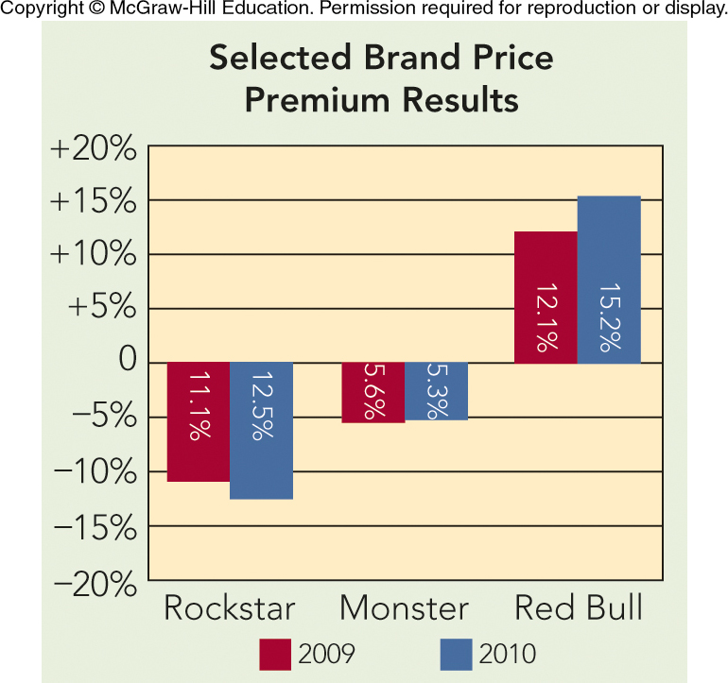
APPLYING MARKETING METRICS Are Red Bull Prices Above, At, or Below the Market?
Price Premium (%)
 | Dollar Sales | Market Share | Unit Volume | Market Share
Brand | 2016 | 2015 | 2016 | 2015
Red Bull | 38% | 37% | 33% | 33%
Monster | 18 | 17 | 19 | 18
Rockstar | 7 | 8 | 8 | 9
Other Brands | 37 | 38 | 40 | 40
 | 100% | 100% | 100%

Slide 37
STEP 5: SET THE LIST OR QUOTED PRICE CHOOSE A PRICE POLICY
Fixed-Price Policy
One price for all…no haggling
Dynamic Pricing Policy
Price can change day to day…supply & demand

Slide 38
STEP 5: SET THE LIST OR QUOTED PRICE BALANCE INCREMENTAL COSTS AND REVENUES
Continually Assess Incremental Costs Against Incremental Revenue
Managerial Analysis Questions:
How Many Extra Units to Sell to Pay for $1,000 Advertisement?
Should Three More Salespeople Be Hired?

Slide 39
Homework Assignment #2
You are the Product Manager at a company launching a brand-new eBook Reader
The features/benefits that you could offer as compared to competition are:
Below market pricing due to extremely low manufacturing costs
Data proving that the screen is “best in class” with best readability/lowest eye fatigue
eBook distribution deals offering comparable content to the market leaders.
Foldable screen technology that allows the “eBook” to fit in your pocket
You must launch three (3) separate readers at different price points.
Defend your pricing strategy (Skimming, penetrating, or market pricing) for each product, and your target demographic using a Market/Product Grid (Chapter #9, page 252, 263 for models)
Homework is due via Turn it in by beginning of class on March 2nd

Slide 40
Homework for Wednesday, February 26th
Chapter 15
Case Study #3, “Game of Thrones”
See you on Wednesday!

Slide 41
The Rady School of Management
MGT 103 Lecture #12
Group Project Update
February 25, 2019

Slide 42
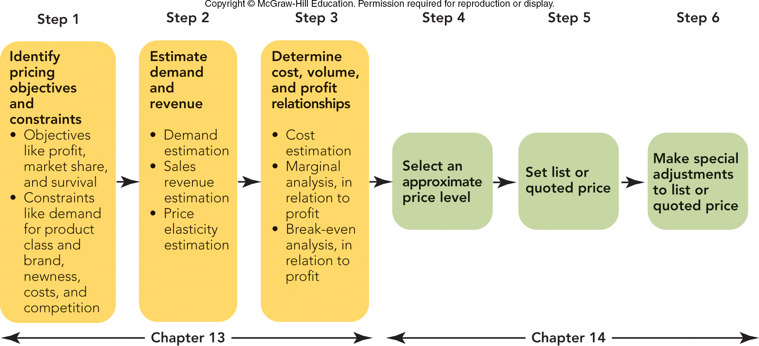
FIGURE 13-2 The six steps in setting price. The first three steps are covered in Chapter 13 and the last three steps in Chapter 14.
Jump to Appendix 2 long image description

Slide 43
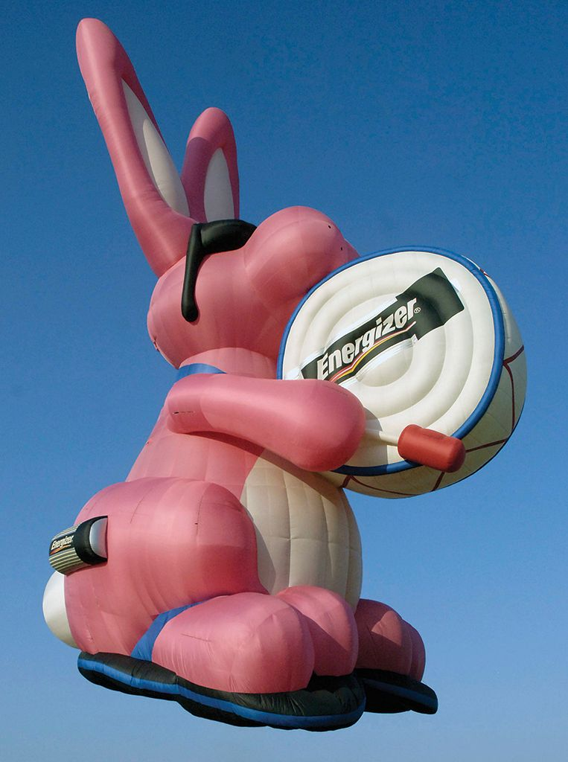
MARKETING MATTERS Energizer’s Lesson in Price Perception—Value
Energizer Priced Advanced Formula Battery at Same Price as its Standard Battery:
But Lost Market Share as Consumers Linked Low Price with Low Quality
Priced e2 High-Performance Battery higher than Duracell, and Higher than Its Own Advanced Formula Battery
Price Increase Resulted in Regained Sales and Market Share
© Joe Marino/Bill Cantrell/UPI/Newscom

